Slide 1

Employee Attrition Prediction
By
Santosh OMPRAKASH

Slide 2
Contents
Problem statement
Proposal
Data Preprocessing
Exploratory Data Analysis (EDA)
Feature Selection
Model Selection and Evaluation
Results
Conclusion

Slide 3
Problem Statement
Employee attrition is departure of employee from organization over time
Voluntary attrition is when employee leaves based on their discretion
Employee can leave organization due to various reason like age, salary, work life balance
Organizations have to hire new people which increases cost and is time consuming process

Slide 4
Proposal
Human Resources problems cannot be determined using specific scientific formula
Machine Learning is the best way to solve this problem
The ‘IBM HR’ dataset is used to predict employee attrition
Organizations can prevent employee attrition using machine learning models and take measures to prevent such actions

Slide 5
Data Preprocessing
The dataset has 34 variables
Some of the variables are Age, Job level, Monthly Income, Work life balance, Years in current role
Target variable is Attrition
Few variables were dropped from further processing as it does not add any value for machine learning model

Slide 6
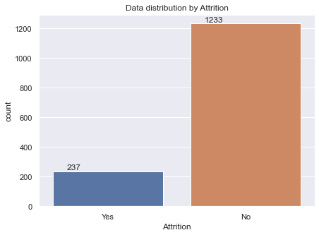
Exploratory Data Analysis (EDA)
Target variable ‘Attrition’ is visualized
‘Yes’ is employees left and ‘No’ is current employees
The dataset is highly imbalanced

Slide 7
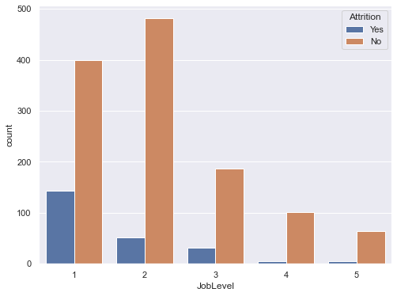
EDA
Job level is visualized for attrition
It shows job level 1 has more attrition

Slide 8
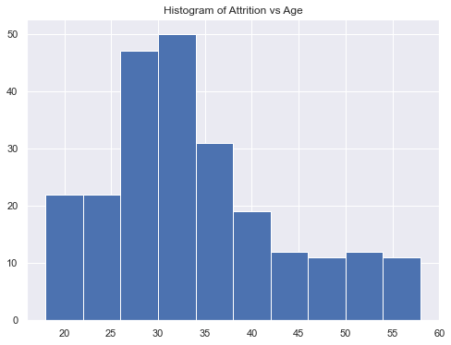
EDA
Attrition at different age groups are visualized
Attrition is more between age group 25 to 35

Slide 9
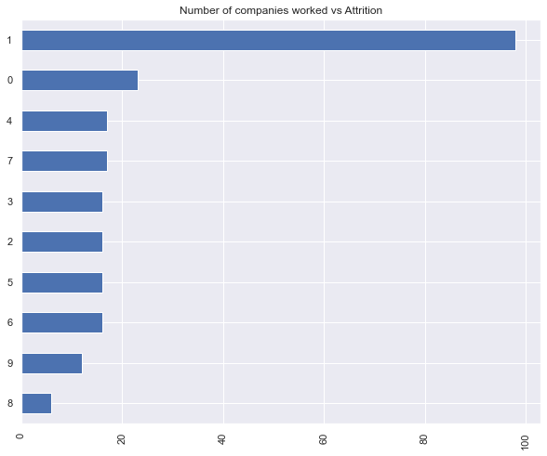
EDA
Attrition data with regards to number of companies worked is visualized
Attrition rate is more when among employee with less prior experience

Slide 10
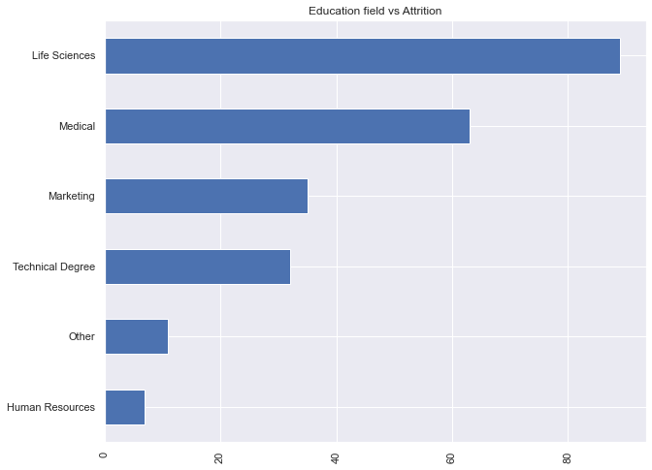
EDA
Attrition related to education field is shown
It is more with employees in Life sciences and Medical field

Slide 11
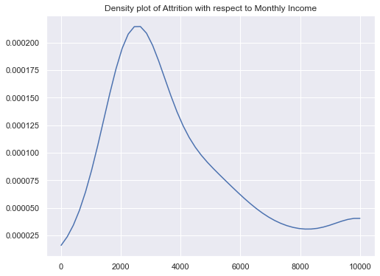
EDA
Attrition with respect to Monthly Income is shown
Attrition is more for salary range $1500 to $3500

Slide 12
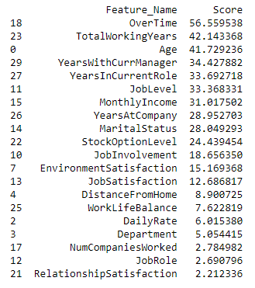
Feature selection
Feature selection is select most important features that will be useful for predictive model
Models with large feature can slow the model training process as it needs more memory
SelectKBest technique is used to select top 20 feature

Slide 13
Model Selection and Evaluation
Label encoder is used to convert text values to numbers
Metric used for models is ROC-AUC (Receiver Operating Characteristic Area Under Curve)
Data is split into train and test – 80% for training and 20% for testing
Normalization is performed using StandardScaler

Slide 14
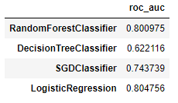
Model Selection and Evaluation
Train data is fit with machine learning algorithms
Logistic Regression has best score of 80%
It was select for tuning

Slide 15
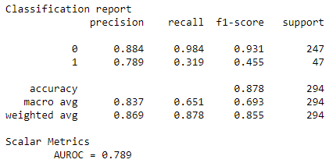
Model Selection and Evaluation
Hyperparameter tuning is performed on Logistic Regression model
The model score increased to 81%
Test data was used with tuned model and model score was 79%

Slide 16
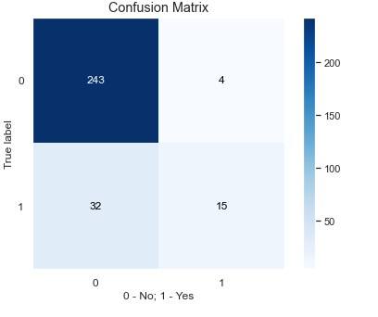
Results
Confusion Matrix of tuned Logistic Regression model is shown
True positive rate is 78.95%
True negative rate is 88.36%

Slide 17
Conclusion
The project goal is to predict employee attrition
Employee attrition is predicted using Logistic Regression machine learning model
Attrition is more in Job level1, between age 25 to 35 and less previous experience
Employee staying longer would reduce additional cost and potential delay in organization commitments

Slide 18





THANK YOU

